Slide 1
In-Class Activity
Class 06A
Taum Sauk Project w/ TI Kits

Slide 2
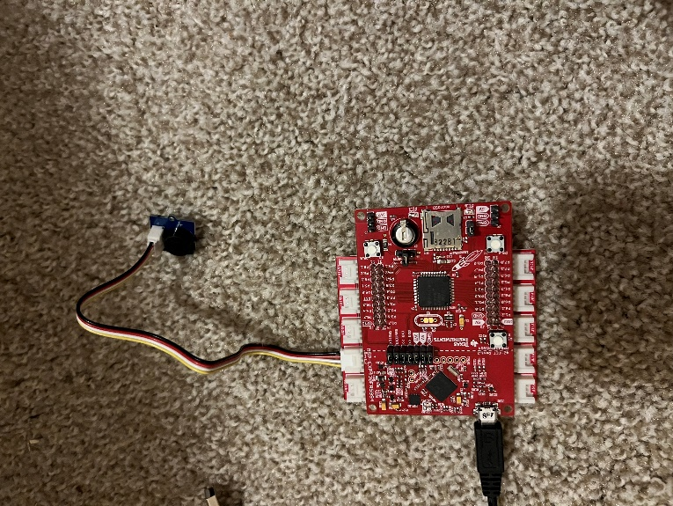
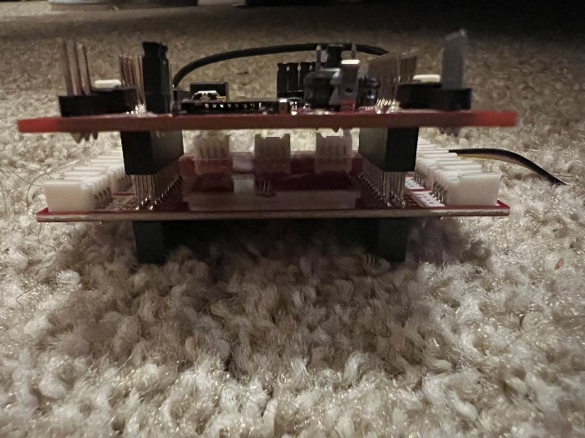
In-Class Activity: Taum Sauk Project w/ TI Kits
Goal: To develop a warning system for the Taum Sauk Reservoir and analyze the error in the Ultrasonic Range Sensor
Outcomes/Expected Results:
Connect the Ultrasonic Range Senor and Buzzer
Modify the code to set off the buzzer within a threshold for the Ultrasonic Range Sensor
Measure and analyze the error in the sensor

Slide 3
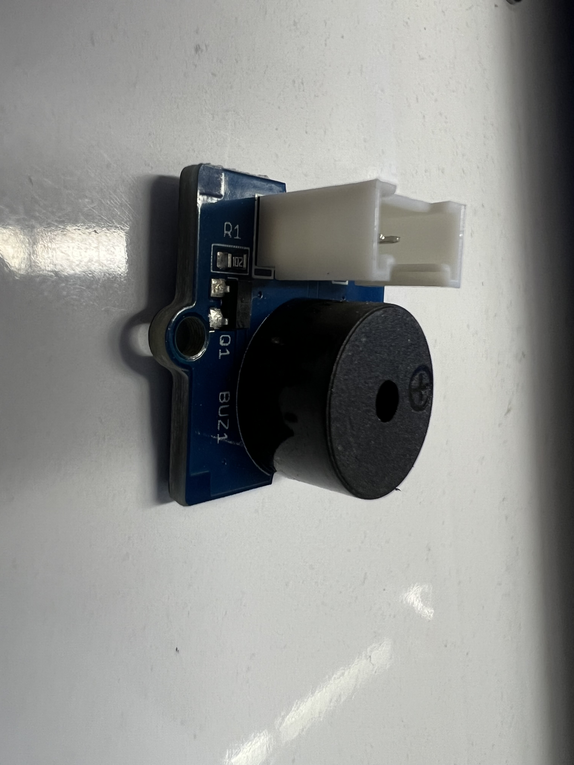
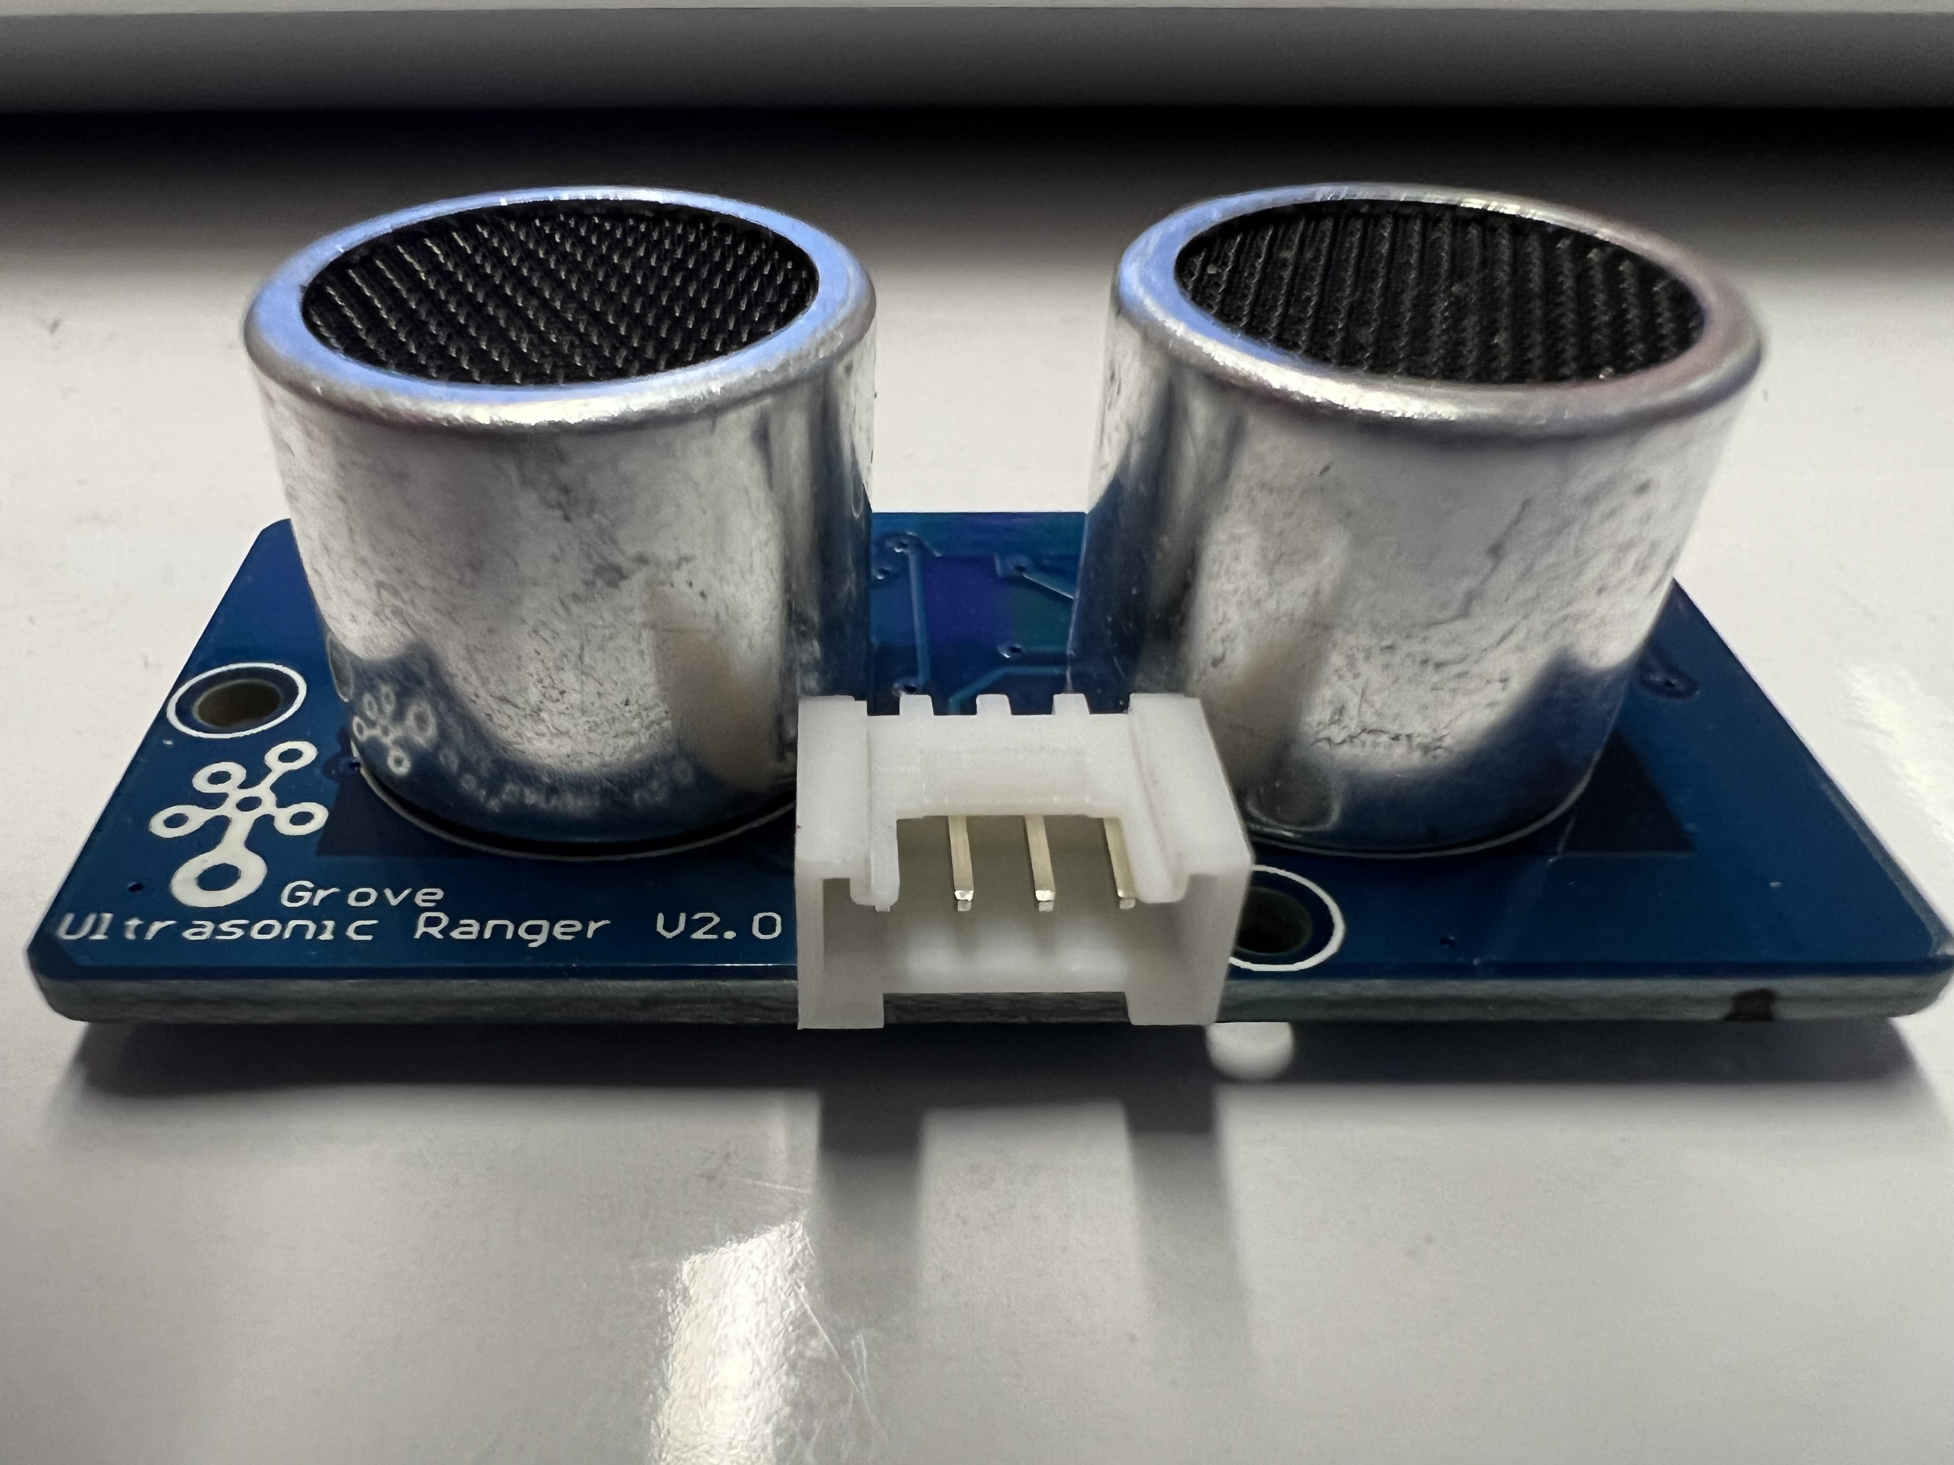
In-Class Activity: Solar Project w/ TI Kits
Equipment List:
TI Kit Microcontroller
TI Kit Breadboard
USB A to Micro USB Powercable
2x Four Prong Connector Cable
Grove Starter Kit Buzzer
Grove Starter Kit Ultrasonic Ranger
Figure 1 (Above): Grove Starter Kit Buzzer
Figure 2 (Below): Grove Starter Kit Ultrasonic Ranger

Slide 4
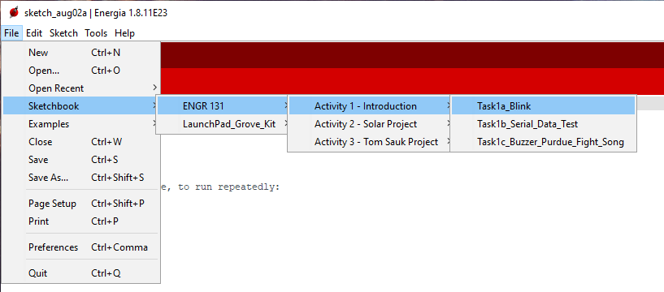
In-Class Activity: Taum Sauk Project w/ TI Kits
Task 3a: Configuring the Ultrasonic Range Sensor
Open the Sketchbook/ENGR 131/Activity 1 – Introduction/Task1a_blink file in Energia.
If you don’t see the ENGR 131 folder in your sketchbook options, please see the Getting Started page for download and instructions.
Compile and upload the Blink sketch to your TI Kit.
HINT: If this works, two lights should be illuminated on your TI Kit.
Create a block diagram of the TI Kits
Take a picture of the blinking TI Kit and add it to your ICA answer sheet

Slide 5
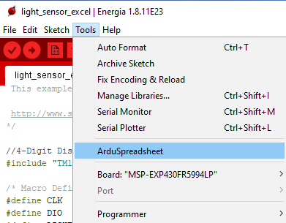
In-Class Activity: Taum Sauk Project w/ TI Kits
Task 3b: Modifying Code using if-else statement
Open the Sketchbook/ENGR131/Activity 3 – Tom Sauk/Task3a_ultrasonic_ranger file
Add the Highlighted Red Text from the example code below to this file.
Before compiling and uploading the sketch, first you need to add to the board.
Starting with the same set up as before, add the Grove Starter Kit Buzzer to J16 of the Booster Pack using the four-prong connector cable.
Add a screenshot of the serial monitor window when 25 data points have been taken to your ICA answer sheet
Record 1-minute of data using the ArduSpreadsheet plug-in. Save this data and upload it with your ICA answer sheet

Slide 6
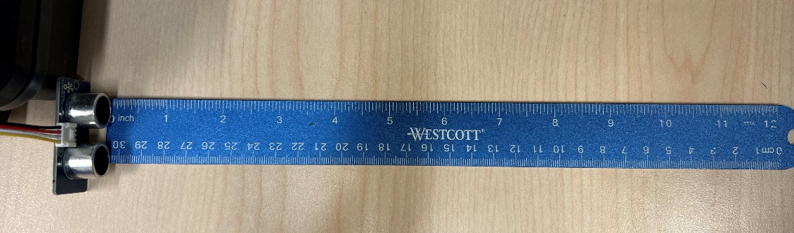
In-Class Activity: Taum Sauk Project w/ TI Kits
Task 3c: Real World Data Collection – Error Analysis
As in Task 3b, utilize the Grove Starter Kit Ultrasonic Range Sensor and Buzzer.
Place a ruler on the table with your Ultrasonic Range Sensor sideways as shown below:
Place your hand at the end of the ruler and slowly move it towards Ultrasonic Range Sensor, when the buzzer goes off, stop moving your hand and measure how far from the sensor it is. Repeat this measurement ten times.

